Slide 1
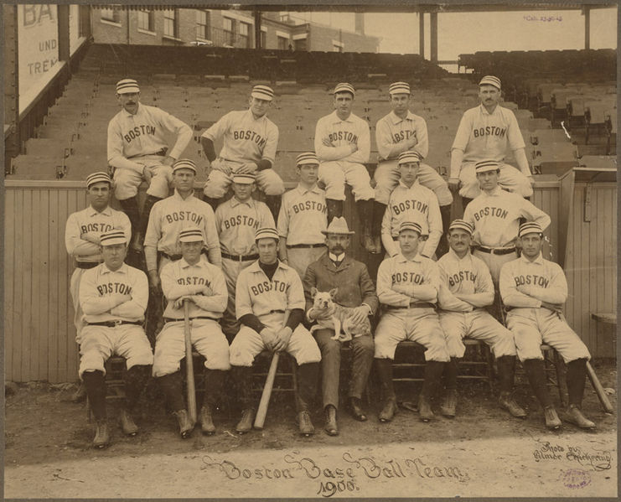
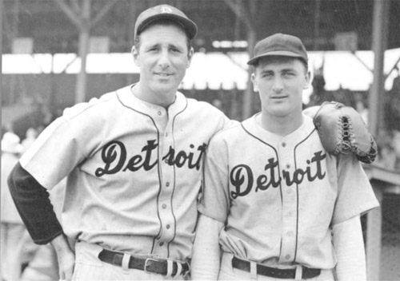
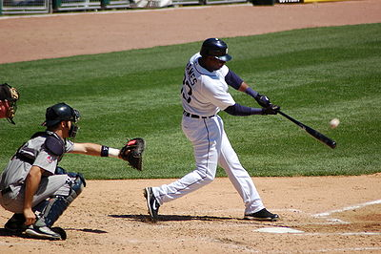
The History of Baseball
When reading nonfiction, readers must solve words including topic-specific vocabulary words

Slide 2
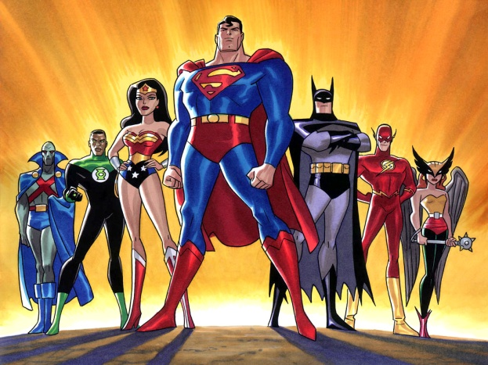
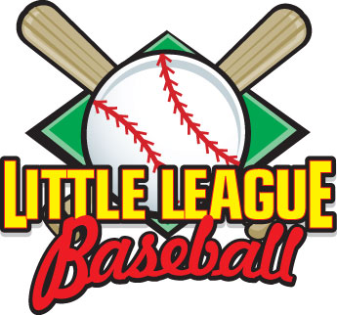
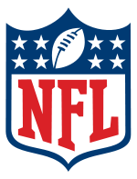
league
The word league first appears in paragraph 6. League is an important word in understanding the topic of baseball.
What does the word league remind you of?
For me, when I see the word league I think of the Justice League, little league , and the NFL (National Football League).
A group of super heroes
National Football League
A group of football teams

Slide 3
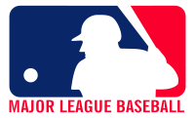
Relating Factor: reminds me of…
Notice the relating factor
league
as
Major league
as
World Series
as
Softball
as
T-ball
The Justice League
Biggest & Best
Professional Sport teams
You will work on the rest of the words independently today.
Be sure to also answer the question in the frame of reference.
Why is making connections when reading unfamiliar words important?

Slide 4
TURN and TALK
League is an important word in understanding the topic of baseball. I think league means _____________ because _________________.

