Slide 1
Word Attack Strategies (Fix-up Strategies)
Skillful readers ability to read long words depends on their ability to break the words into syllables. This is true for familiar and unfamiliar words.

Slide 2
What would be the outcome/effect?
If I am constantly skipping words in each paragraph then I’m not understanding the story. If the story is missing meaning for me then I will have a difficult time finding the correct answers on STAAR.
When I get to a word I don’t know I skip it or I say a word that I think it is and read on.

Slide 3
What do I need to do?
Look at word bits, word parts, and words you already know= WORD ATTACK
Read and re-read for accuracy and understanding
Use context clues to help find meaning to unknown words

Slide 4
persimmon
How would I sound this out?
per | sim | mon
What parts to the word do I know?
A part of the word I know is __________________.
Can I connect this word to another word I know? Does this word have similar patterns?
This word is similar to ______________ because _________________.
What do I know about this word?
This word is in my working knowledge/ schema because ________________.

Slide 5
persimmon
When he saw the rice ball, he wanted it. He had just eaten a persimmon fruit and had the seed in his hand.
The part of the text that helped me understand what persimmon means is ____________________________________.

Slide 6
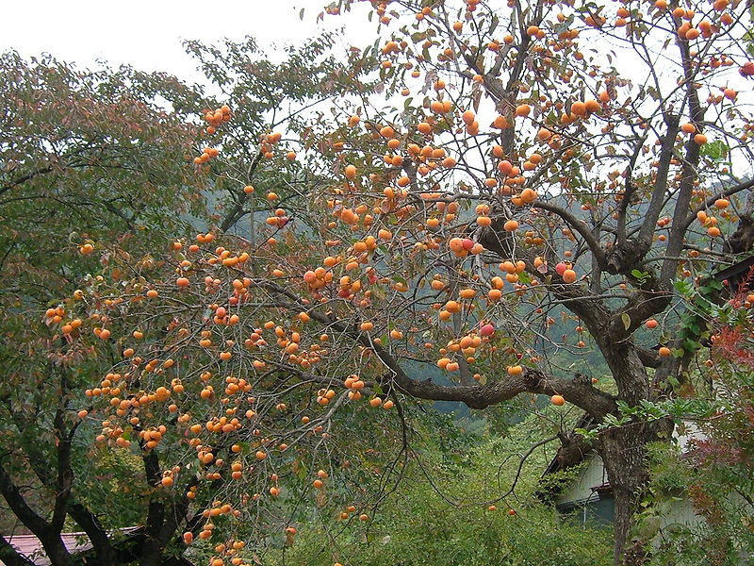
Persimmon tree in Japan

Slide 7
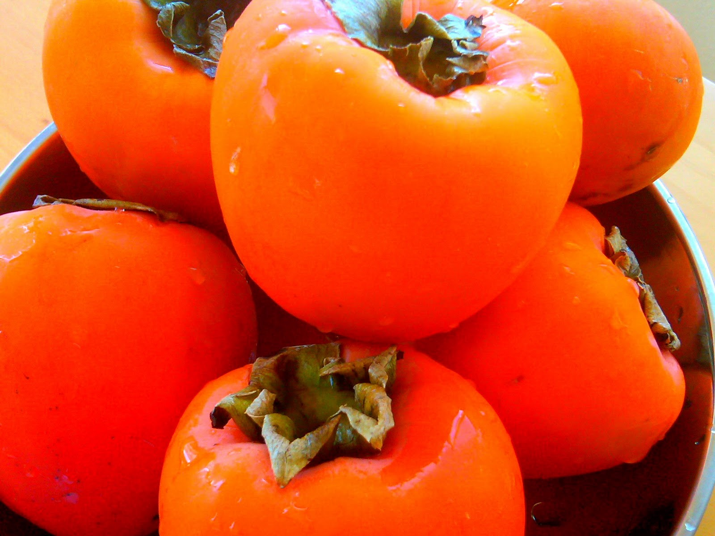
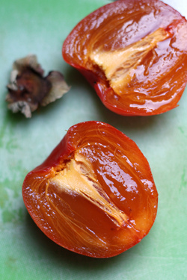
persimmon

Slide 8
What are the outcomes/effects?
When I get to a word I don’t know I attack it with strategies that help me read the word correctly.

